Slide 1
The New Investment Climate & Opportunities in Myanmar
Thaung Tun
Union Minister for Investment and Foreign Economic Relations

Slide 2
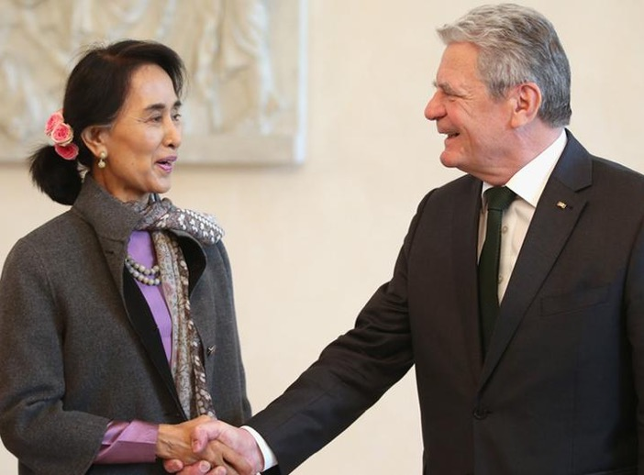
Contents
Change & Transformation in Myanmar
The New Myanmar Investment Regime
German Investment in Myanmar
Opportunities in Myanmar
H.E. Joachim Wilhelm Gauck (President of Germany 2012-2017) meeting with H.E. Daw Aung San Suu Kyi

Slide 3
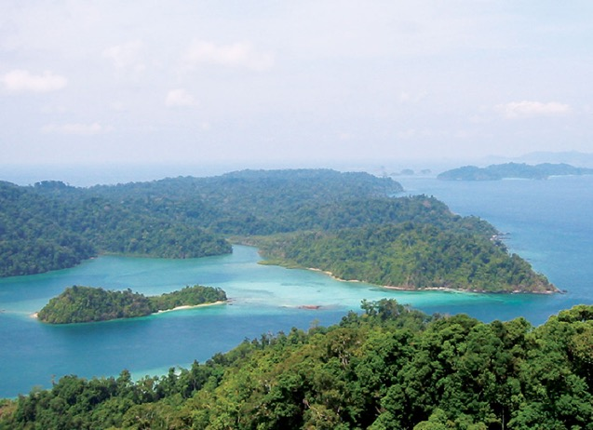
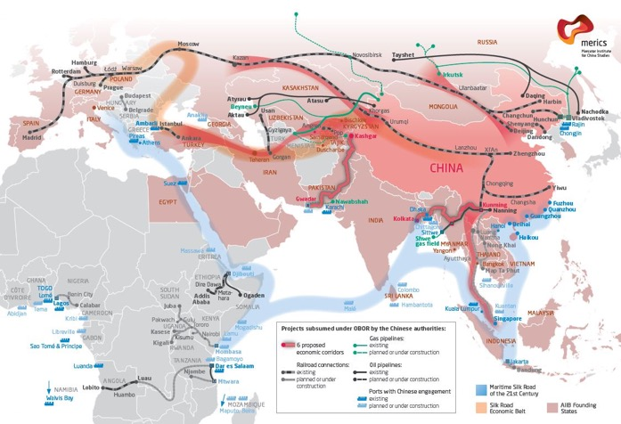
Geography
Sandwiched between China and India
A land bridge between South and South East Asia
Long coastlines
Abundant natural resources

Slide 4
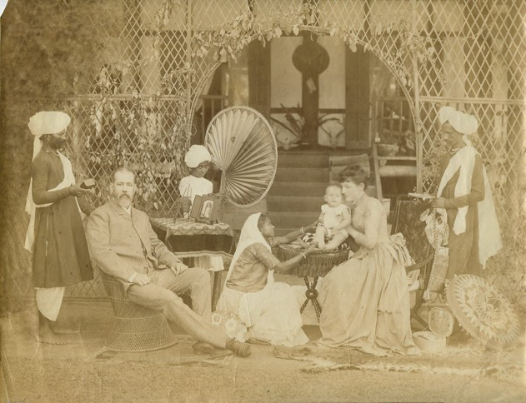
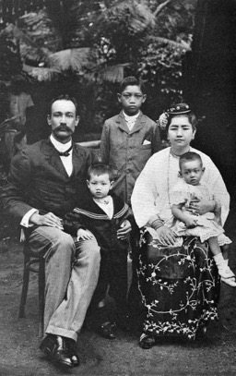
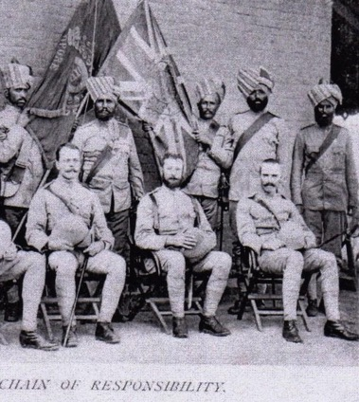
History
Diverse communities
Colonial legacies
Over six decades of internal conflict
Economic mismanagement

Slide 5
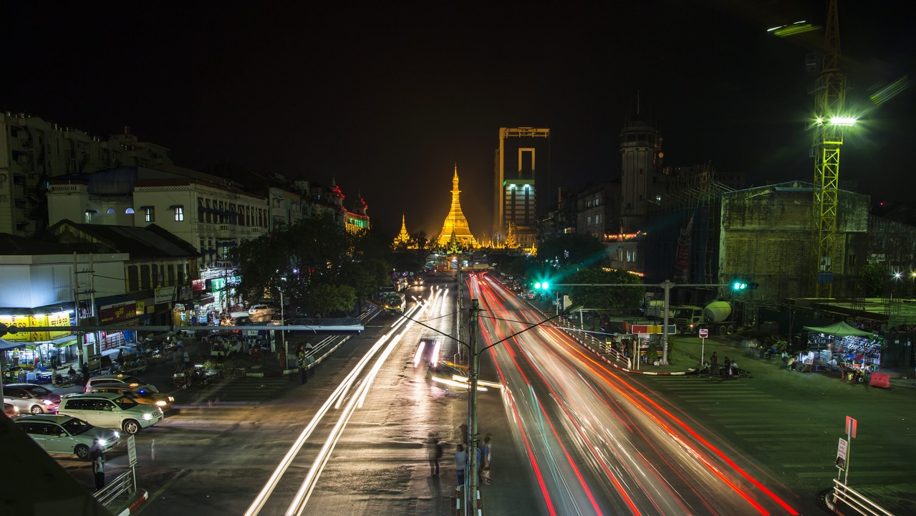
Change and Transformation in Myanmar

Slide 6
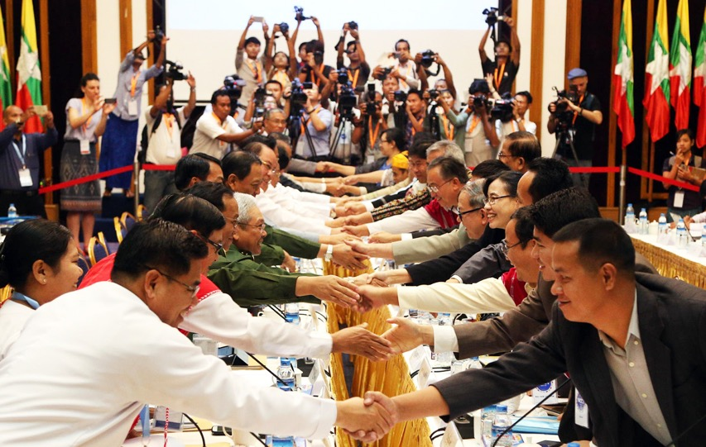
The Change
dictatorship to democracy
planned economy to market economy
conflict to sustained peace

Slide 7
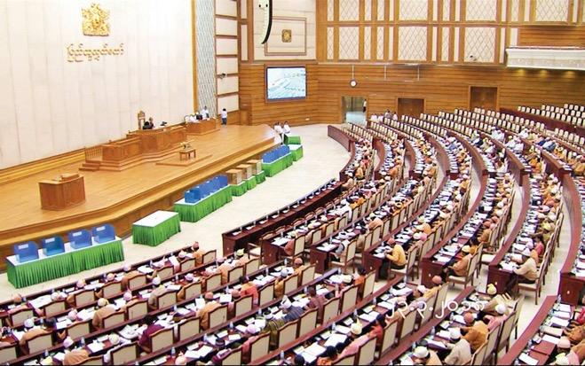
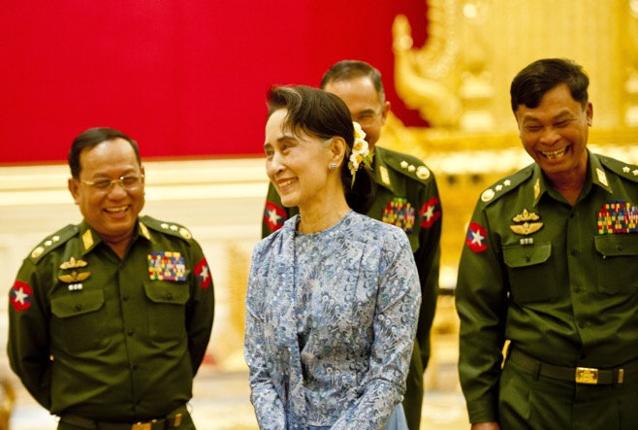
Political Transition
Transition from Authoritarian Rule (2011-2015)
2008 Constitution and 2010 General Election transferred power to the USDP Party led by then President U Thein Sein
Daw Aung San Suu Kyi successfully contested the 2012 by-election and became a Member of Parliament
Sanctions revoked
Transition into a Civilian Rule (2016-Present)
Free and fair 2015 General Election brought the new National League for Democracy (NLD) government into power
Daw Aung San Suu Kyi became State Counsellor and de facto leader of Myanmar

Slide 8
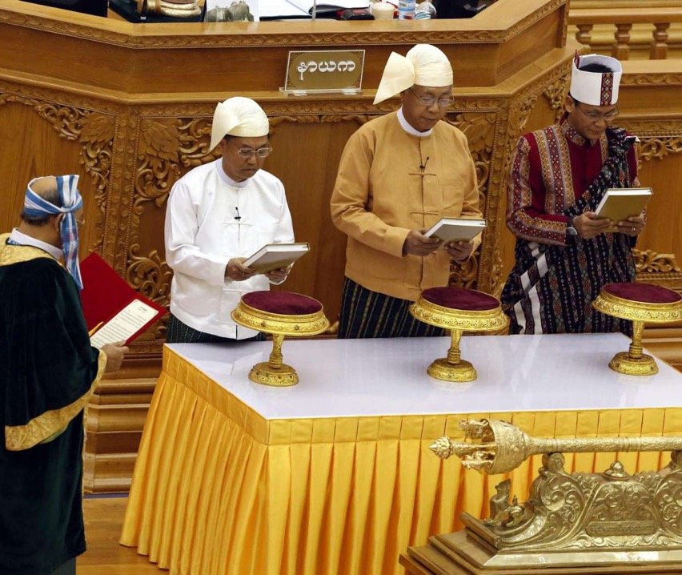
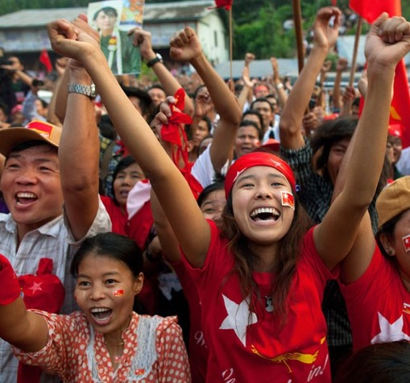
The NLD Administration
A clear vision to build a peaceful, prosperous and democratic Myanmar
Four major policy focus areas
National Reconciliation
Internal Peace
Constitutional Amendment
Socio-Economic Development

Slide 9
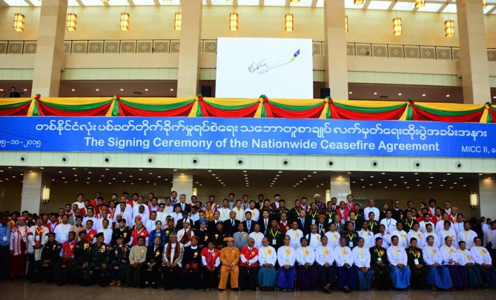
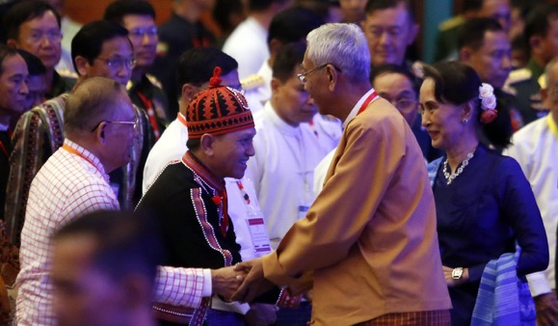
The Peace Process
Nationwide Ceasefire Agreement
Signed by 8 armed groups in October 2015
Two more groups signed in February 2018
Political Dialogue
Four Rounds of Union Peace Conference (21st Century Panglong) in 2016, 2017 and 2018
51 points signed as part of the Union Accord to create a Federal Democratic Union

Slide 10
Economic
Transformation
Legal Reform: Investment Law; Myanmar Companies Law; Intellectual Property Bill
Institutional Reform: Creation of the new Ministry of Investment and Foreign Economic Relations and Anti-Corruption Agency
Fiscal and Monetary Reform: Introduction of Public Financial Management; Floating Exchange Rate;
Myanmar Sustainable Development Plan launched in August 2018

Slide 11
Founded upon the objective of giving coherence to policies and institutions necessary for genuine, inclusive and transformational growth
Recognises the economic dividends of being a democracy
Aligned with SDGs and regional commitments such as the Greater Mekong Sub-Region Strategic Framework and the ASEAN Economic Community
The Myanmar sustainable Development Plan
“A Peaceful, Prosperous & Democratic Myanmar”
3
Pillars
5
Goals
28
Strategies
251
Action Plans
Goal 1:
Peace, National Reconciliation, Security & Good Governance
Goal 4:
Human Resources & Social Development for a 21st Century
Goal 3:
Job Creation & Private Sector Led Growth
Goal 2:
Economic Stability & Strengthened Macroeconomic Management
Goal 5:
Natural Resources & the Environment for Posterity of the Nation
Pillar 1:
Peace &
Stability
Pillar 2: Prosperity & Partnership
Pillar 3:
People &
Planet
Notes:
Brief overview of the MSDP structure.

Slide 12
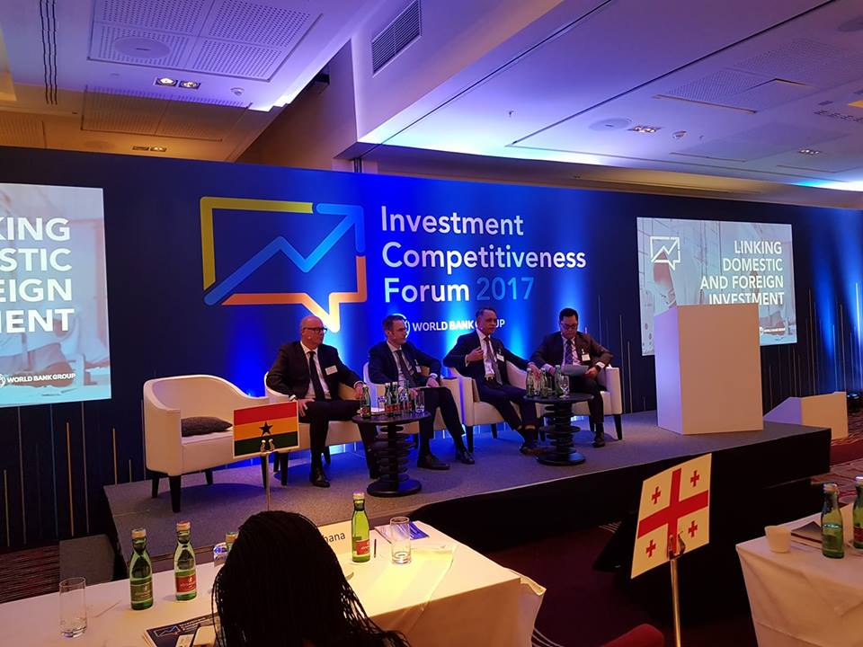
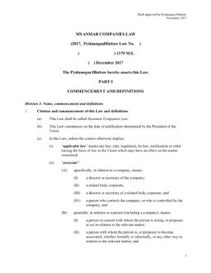
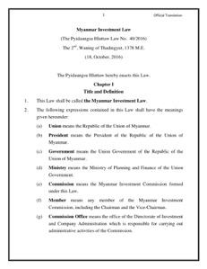
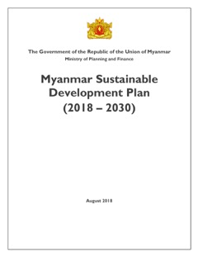
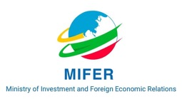
A Favourable Business Environment
Myanmar Sustainable Development Plan
Facilitates genuine, inclusive and transformational growth
Myanmar Investment Law
Creates a level playing field between foreign and domestic investors
Ministry of Investment and Foreign Economic Relations
Create a ‘single window’ through which to do business

Slide 13
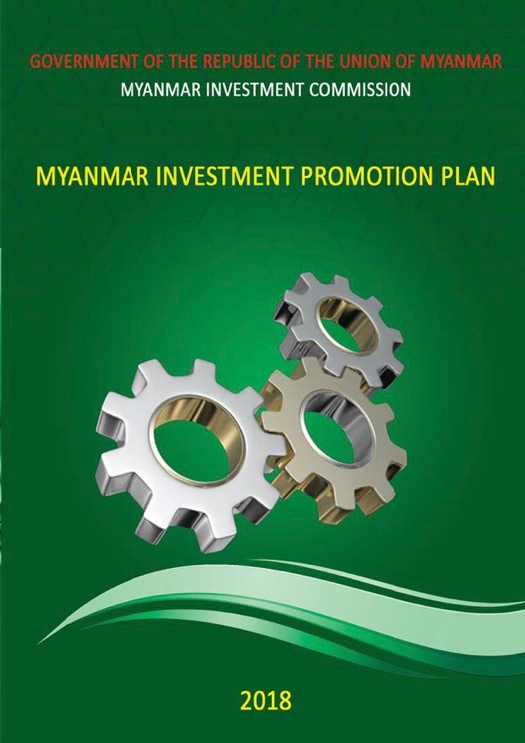
Investment Incentives
Right to Use Land
Foreign investor may lease land or buildings for up to an initial period of 50 years from the date of receipt of permit or endorsement
Extension of 10 years and a further consecutive extension period of 10 years may be obtained with the approval of the MIC (10+10 years extension rights)
Exemptions & Reliefs
Income Tax
Customs Duty and Other Taxes
Generalised Scheme of Preference (GSP) by the EU and US
Duty-free, Quota-free Market Access
Notes:
Brief overview of the MSDP structure.

Slide 14
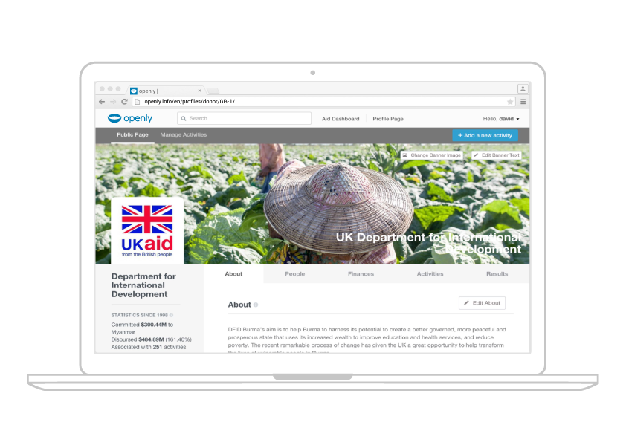
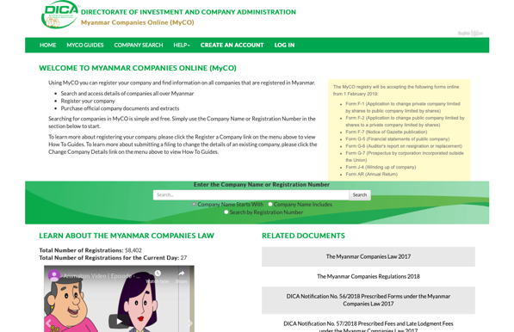
Myanmar Companies Online (MyCO)
Streamlines and simplifies company registrations and filings through electronic services online
Notes:
Brief overview of the MSDP structure.

Slide 15
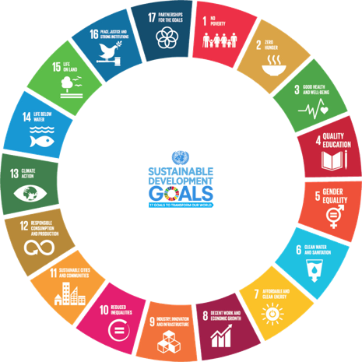
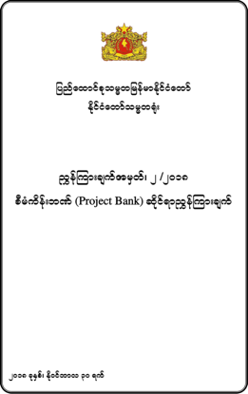
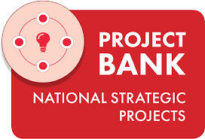
Launch of the National Project Bank
Launching of the National Project Bank at Invest Myanmar Summit 2019
Showcases strategic projects aligned with the Myanmar Sustainable Development Plan (MSDP)
Many of these projects will be eligible for private sector financing; an investment opportunity not to be missed!
Enables the prioritisation of key projects that will enable effective implementation of the MSDP
Power Generation & Transmission
Bridges & Tunnels
Airports
Waterways
Digital / E-Government

Slide 16
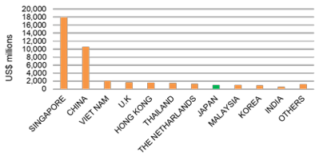
Foreign Investment by Country
(2011/12 - Dec 2018)
Foreign Investment by Sector
(2011/12 - 2018)

Slide 17
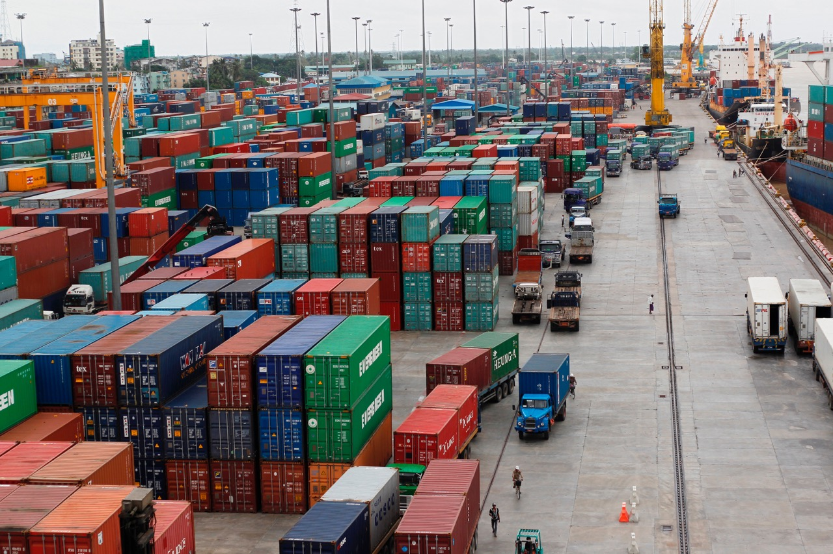
The New Myanmar Investment Regime

Slide 18
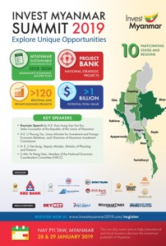
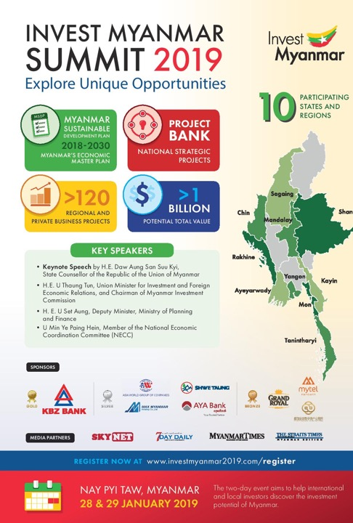
The New Investment Regime
Proactive
Transparent
Efficient
Notes:
Brief overview of the MSDP structure.

Slide 19
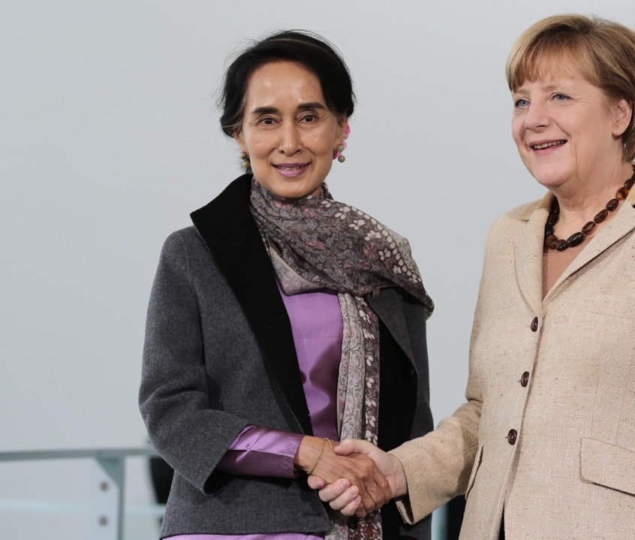
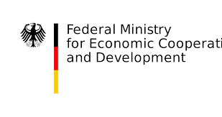
Myanmar and Germany
Established diplomatic relations on 3 August 1954
The first German consulate in the Southeast Asian country set up in Yangon
A reliable partner supporting reforms towards democracy and market economy as well as on the strengthening of civil society.
Technical support from BMZ, GIZ, BGR, PTB and KfW
Office of the Delegation of German Industry and Commerce established in February 2014
Notes:
Brief overview of the MSDP structure.

Slide 20
Myanmar and Germany in Numbers
Bi-lateral trade: USD 584 million (2017-18)
28th largest investor: USD 32.651 million (Dec 2018)
4 German investment projects
54 German registered companies
28,838 German tourists (2018)
German Assistance: USD 35.6 million / Third largest (2018)

Slide 21
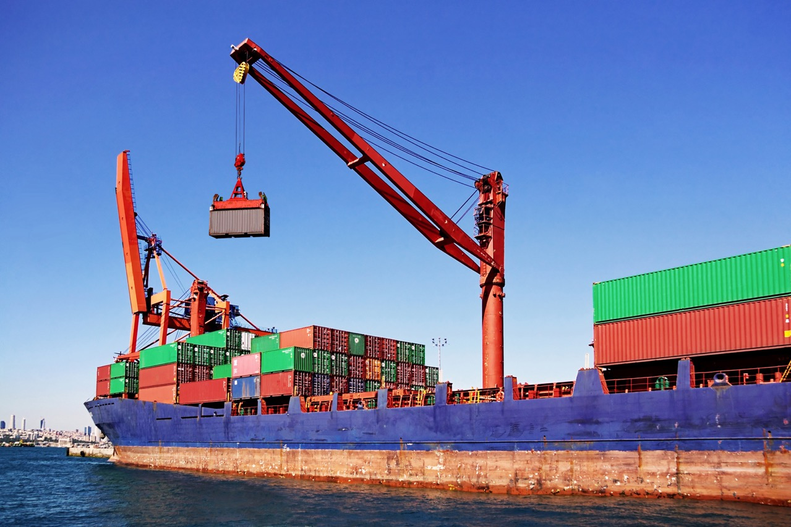
Why Invest in Myanmar?

Slide 22
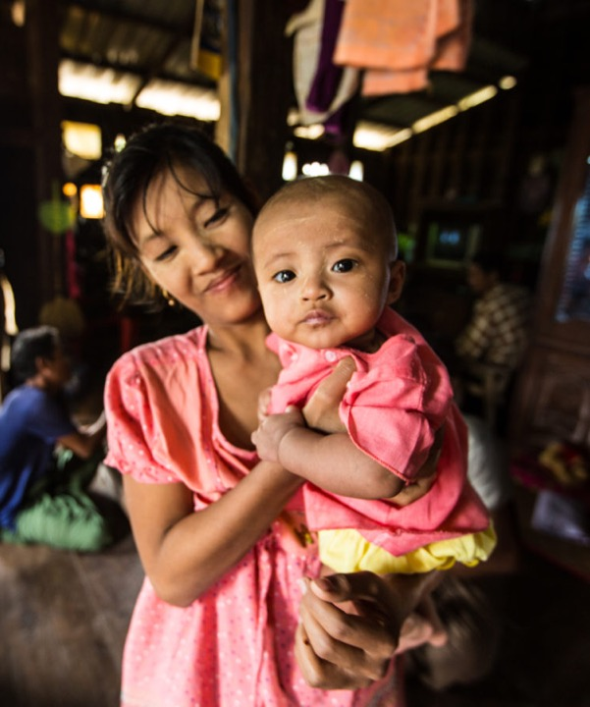
A growing economy
Location & Connectivity: Shaping Asia’s new crossroads
Transitioning towards a democratic state
Abundant resources awaiting to be untapped
Profiting from a liberal, transparent and business-enabling environment

Slide 23
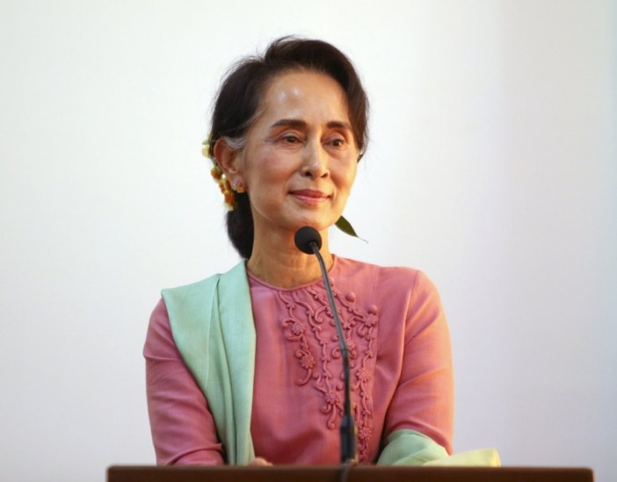
“Please do come to Myanmar, soak in an atmosphere brimming with opportunities, and witness our newfound economic vibrancy with your own eyes."
H.E. Daw Aung San Suu Kyi State Counsellor
(Myanmar Investment Summit, January 2019)
Notes:
The State Counsellor is keen to make the MSDP a success. I suspect MoIFER will play an essential role in ensuring sufficient external resources are available to ensure successful implementation.

Slide 24
Thank you!

Slide 25
Questions and Answers
Thank You

