Slide 1


EEC Factsheet
The Eastern Economic Corridor Office of Thailand

Slide 2











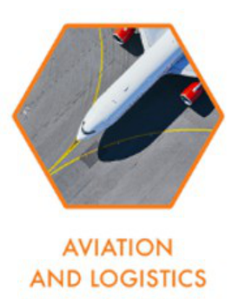



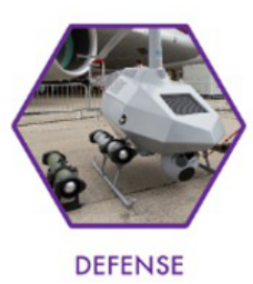

What is EEC?
The Eastern Economic Corridor (EEC) is an area-based development initiative,
aiming to revitalize the well-known Eastern Seaboard where, for 30 years,
numerous business developers have experienced a rewarding investment journey and exceptional achievements. The EEC project initially focused on the 3 Eastern provinces. The EEC development plan envisions a significant transformation of both physical and social development, uplifting the country’s competitiveness.
Location: Rayong, Chonburi, and Chachoengsao
Provinces
Area: 1,326,600 Hectares
(8,291,250 Rai)
EEC Mission
The Eastern Economic Corridor Office of Thailand (EECO) is the secretariat office of the EEC Policy Committee with 3 main missions :
1) Sustainable Area-based Development
2) Comprehensive Infrastructure and Connectivity
3) Promoting Advanced Technology and Innovation
EVER-GROWING POTENTIAL
Access to Large & Growing Market
A Strategic Location as a Gateway to Asia
Asia contributes to 60% of world population (2020)
Thailand is well positioned
at the Center of South East Asia
East Asia & Pacific’s GDP per Capita grows at 3.21% per year compared to world at 1.38% (2019)
Thailand ranked 2nd in ASEAN Logistic Performance Index
FOCUSED INVESTMENT THEMES
HEALTH
DIGITAL
LOGISTICS
CIRCULAR & GREEN ECONOMY
EDUCATION AND HUMAN RESOURCE DEVELOPMENT

Slide 3
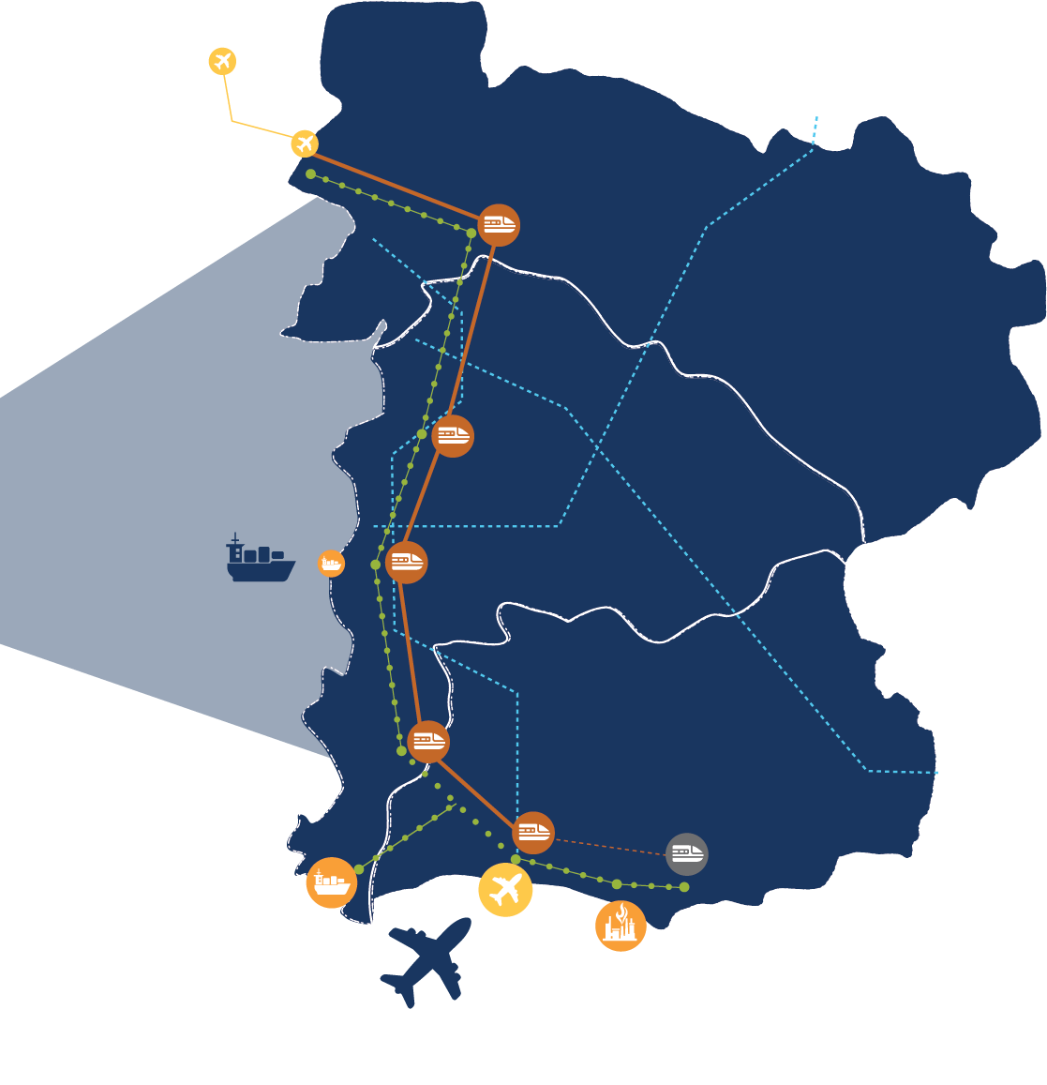

















Don Mueang International Airport
Motorway
Bangkok – Pattaya – Rayong
Comprehensive Infrastructure
Suvarnabhumi International Airport
Dual Track Train
High Speed Rail
Chachoengsao Station
Chachoengsao
Connect Bangkok with EEC area
linking 3 airports with < 60 minutes travel time
High Speed Rail
Chonburi Station
Estimated start of operation: 2025
Connectivity: 5 provinces, 3 major international airports of Bangkok with 9 high-speed stations
Distance: 220 km
Train maximum speed: 250 km per hour
Travel time: less than an hour
Laem Chabang Port
Si Racha Station
Chonburi
Pattaya Station
Rayong
U-Tapao Station
Rayong Station
U-Tapao International Airport
Sattahip Commercial Port
U-Tapao International Airport
Map Ta Phut
Industrial Port
The 3rd International Airport of Bangkok
Estimated start of operation: 2025
Location: Rayong Province
Capacity: 60 million passengers per year
Facilities: Passenger Terminal, Ground Transportation Center, Air Cargo Terminal, Maintenance Repair and Overhaul Service Center (MRO), Free Trade Zone and Aviation Training Center
Map Ta Phut Industrial Port Phase 3
Expand the capacity of the shipment hub in Southeast Asia
Laem Chabang Port Phase 3
Estimated start of operation: 2026 (LNG Terminal)
Location: Rayong Province
Capacity: 31 million tons of gas and liquid cargo shipment per year
Liquefied Natural Gas Terminal: 20 million tons per year
Future Projects;
  Liquid Material Terminal: 11 million tons per year
  Warehouse & Power Plant
Equip the largest sea port in Thailand with automated system as the foundation for the Regional Logistics Center
Estimated start of operation: 2025 (Terminal F)
Location: Chonburi Province
Capacity;
  Container throughput of 18 million TEU per year
  Land transportation capacity 3 million cars per year
  Automatic Container Management System
12 TARGETED INDUSTRIES
Next-Generation Automotive
Advanced Agriculture & Biotechnology
Aviation & Logistics
Electric Vehicles (EV)
Autonomous Vehicles (AV)
Precision Agriculture
Bio-Refinery & Bio-Extraction
Post-Harvest Management
Gene Editing for Plants & Animals
Aviation
  Maintenance Repair and Overhaul (MRO)
  OEM for Aircraft & Parts
  Ground Service Equipment
Logistics
  High-Value Logistics
  Smart Logistics Solutions
Intelligent Electronics
Food for the Future
Smart Appliances
Micro Electronics Design
5G Components Manufacturing
Nutrition & Supplements
Functional Food
Novel Food & Plant-Based Food
Flavors & Fragrance
Biofuel & Biochemical
Automation & Robotics
Specialty Materials (Bioplastic)
Biochemical (Fatty Acids, Oleochemicals, Lactic Acids)
Biofuel (Bioethanol, Biodiesel)
Industrial Robots
Service Robots
System Integrations
Medical & Comprehensive Healthcare
Next-Gen Health Therapy
  Precision Medicine & Biopharma
  Regenerative Medicine & Advanced Cosmeceuticals
Pharmaceuticals & Biopharmaceuticals
Medical Device
Digital Health
Defense
Digital
Import Substitution
Maintenance
Disaster Management
Software & Platform
  Artificial Intelligence
  Big Data & Advanced Analytics
Digital Infrastructure
  Cloud (IaaS) & Data Center
  Cyber Security
Education & Human Resource Development
High-Value & Medical Tourism
International Universities
Certification Bodies for Professional Skills
Edu Tech
Medical & Wellness Tourism
MICE & Mega Event
Notes:
http://www.btsgroup.co.th/en/update/news-event/606/signing-ceremony-for-public-private-partnership-agreement-of-u-tapao-international-airport-city-project-eastern-airport-city-project
https://www.bangkokpost.com/business/1853014/consortium-ready-to-start-work-on-high-speed-rail

Slide 4
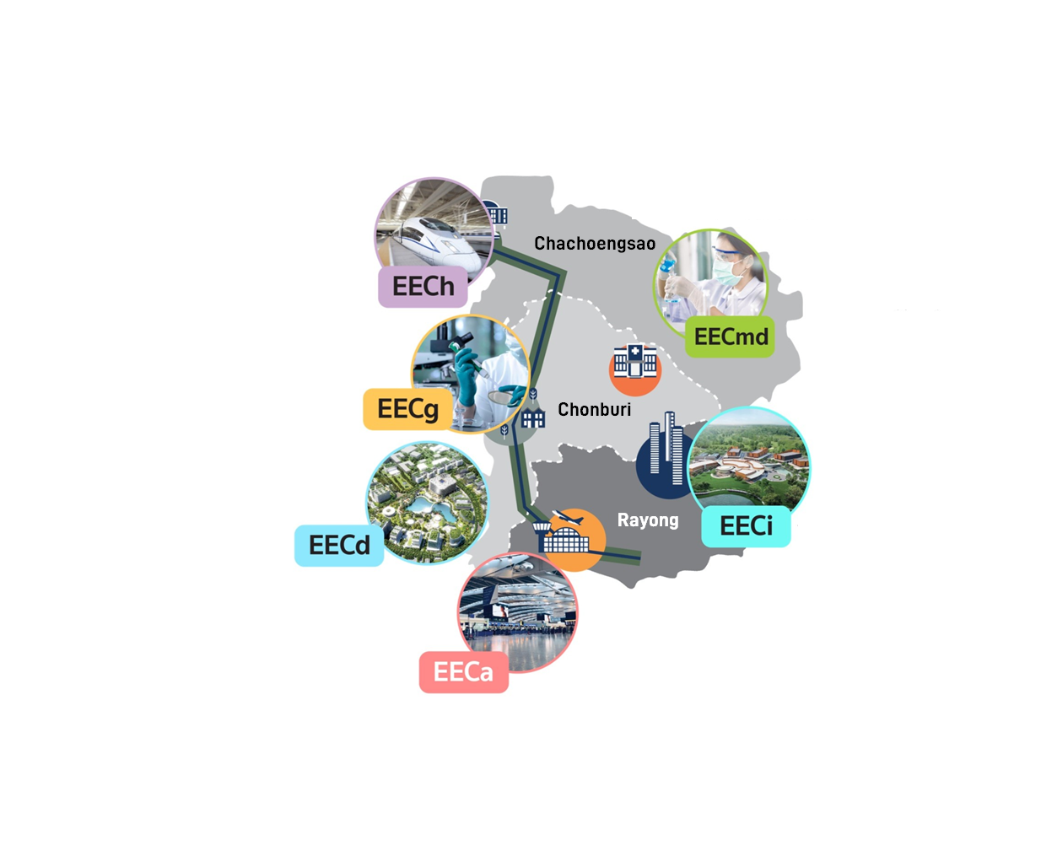
Promoted Zones For Specific Industries
With EEC exceptional characteristics, this provides distinguished investment opportunities for all investors.
In order to drive your business towards a remarkable success, EEC has established Promoted Zones For Specific Industries and Promoted Zones for Targeted Industries to serve prospective investors around the world. Investors in 12 targeted industries will also be eligible to explore additional privileges.
The EEC development scheme will strengthen the existing foundation and contribute to sustainable business growth, with the best mutual benefits.
EECh, High-Speed Rail Ribbon Sprawl
Location: Along the high-speed rail track that crosses Don Mueang, Suvarnabhumi, and U-Tapao Airport
Distance: 220 Kilometer
EECmd, Medical Hub
Location: Bang Lamung District, Chonburi
Area: 90.56 Hectares (566 Rai)
EECh consists of a High-Speed Railway and the Transit-Oriented Development area (TOD) located at the Makkasan and Si Racha Station, measuring 22.4 Hectares (140 Rai) and 4 Hectares (25 Rai), respectively.
EECmd is aspired to become Thailand’s first medical hub, where the area would offer complete health care and medical services. EECmd aims to elevate Thailand’s health services and equip the country for the expansion of its aging population.
EECg, Genomics Thailand
Location: Burapha University, Chonburi
Area: 0.6 Hectares (3.69 Rai)
EECg is the genomics testing hub in EEC built upon a collaborative research network ,empowered by the Next-Generation Sequencing Technology.
EECd, Digital Park
Location: Si Racha District, Chonburi
Area: 113.28 Hectares (708 Rai)
EECi, Innovation Platform
Location: Wangchan Valley, Rayong
Area: 480 Hectares (3,000 Rai)
EECd is the future destination for digital global players and digital biz innovation to explore, develop, and acquire original digital technology for thriving digital business. It consists of the world-class data center, digital innovation testbed and IoT institutes which are fully equipped with high –tech facilities.
EECi is a novel ecosystem designed to promote innovation and upgrade modern technology that will serve future business needs. A complete ‘innovation ecosystem’ will transform technological and innovation research into practical industrial applications.
EECa, Eastern Airport City
Location: U-Tapao International Airport, Rayong
Area: 1,040 Hectares (6,500 Rai)
EECa consists of business and facilities in the U-Tapao International Airport, including a commercial gateway, a cargo terminal, an aviation training center, an MRO center, and Free Trade Zone that will enhance business operations and provide a world-class experience for everyone.

Slide 5

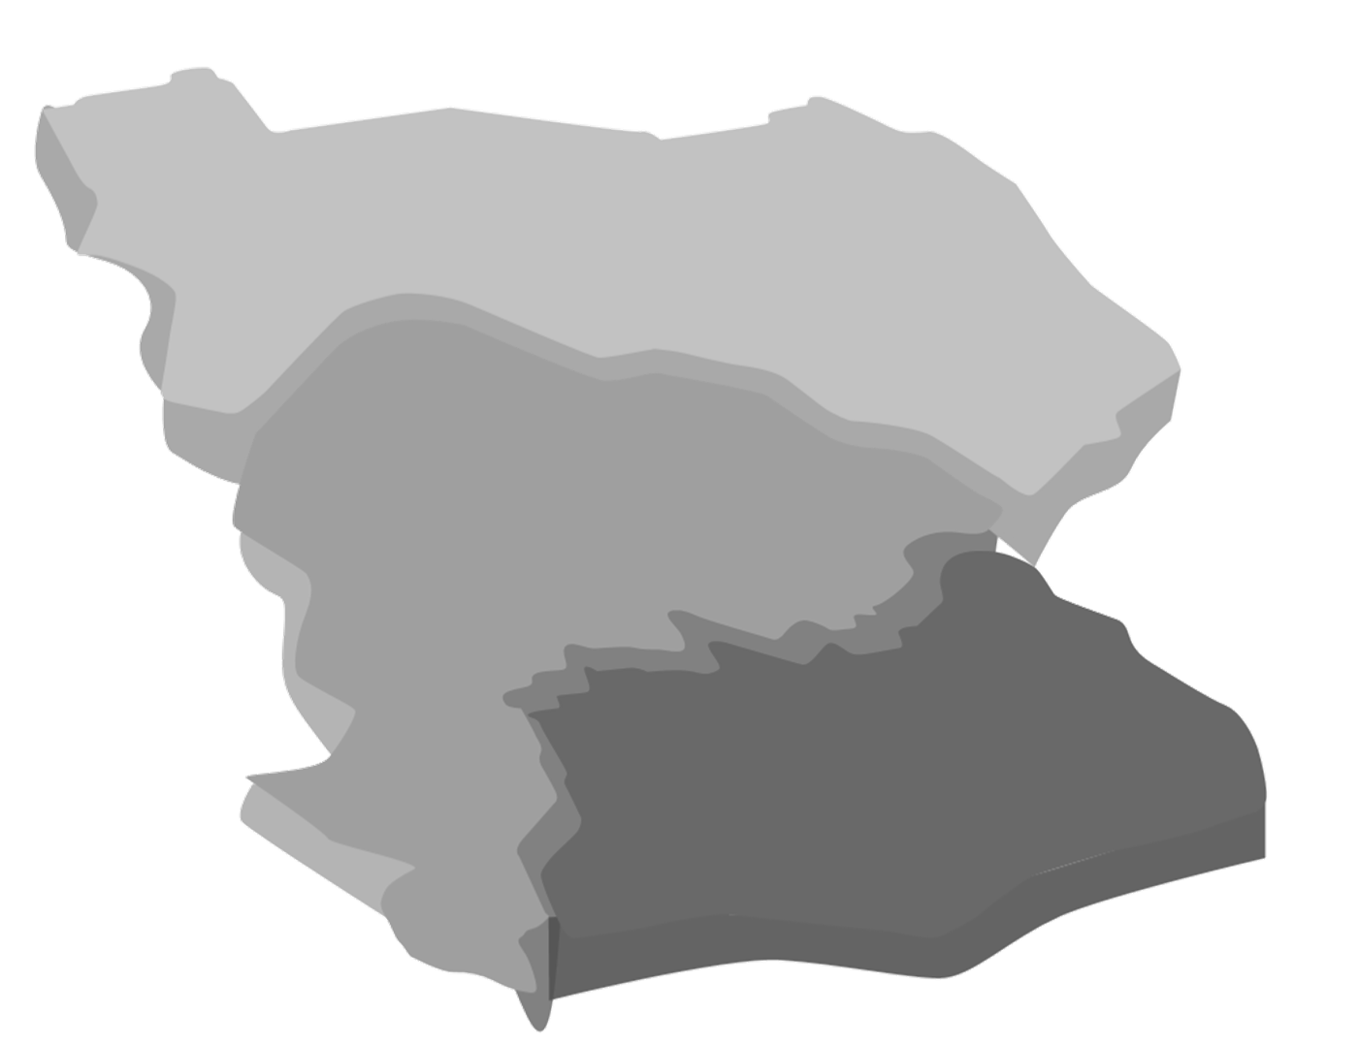








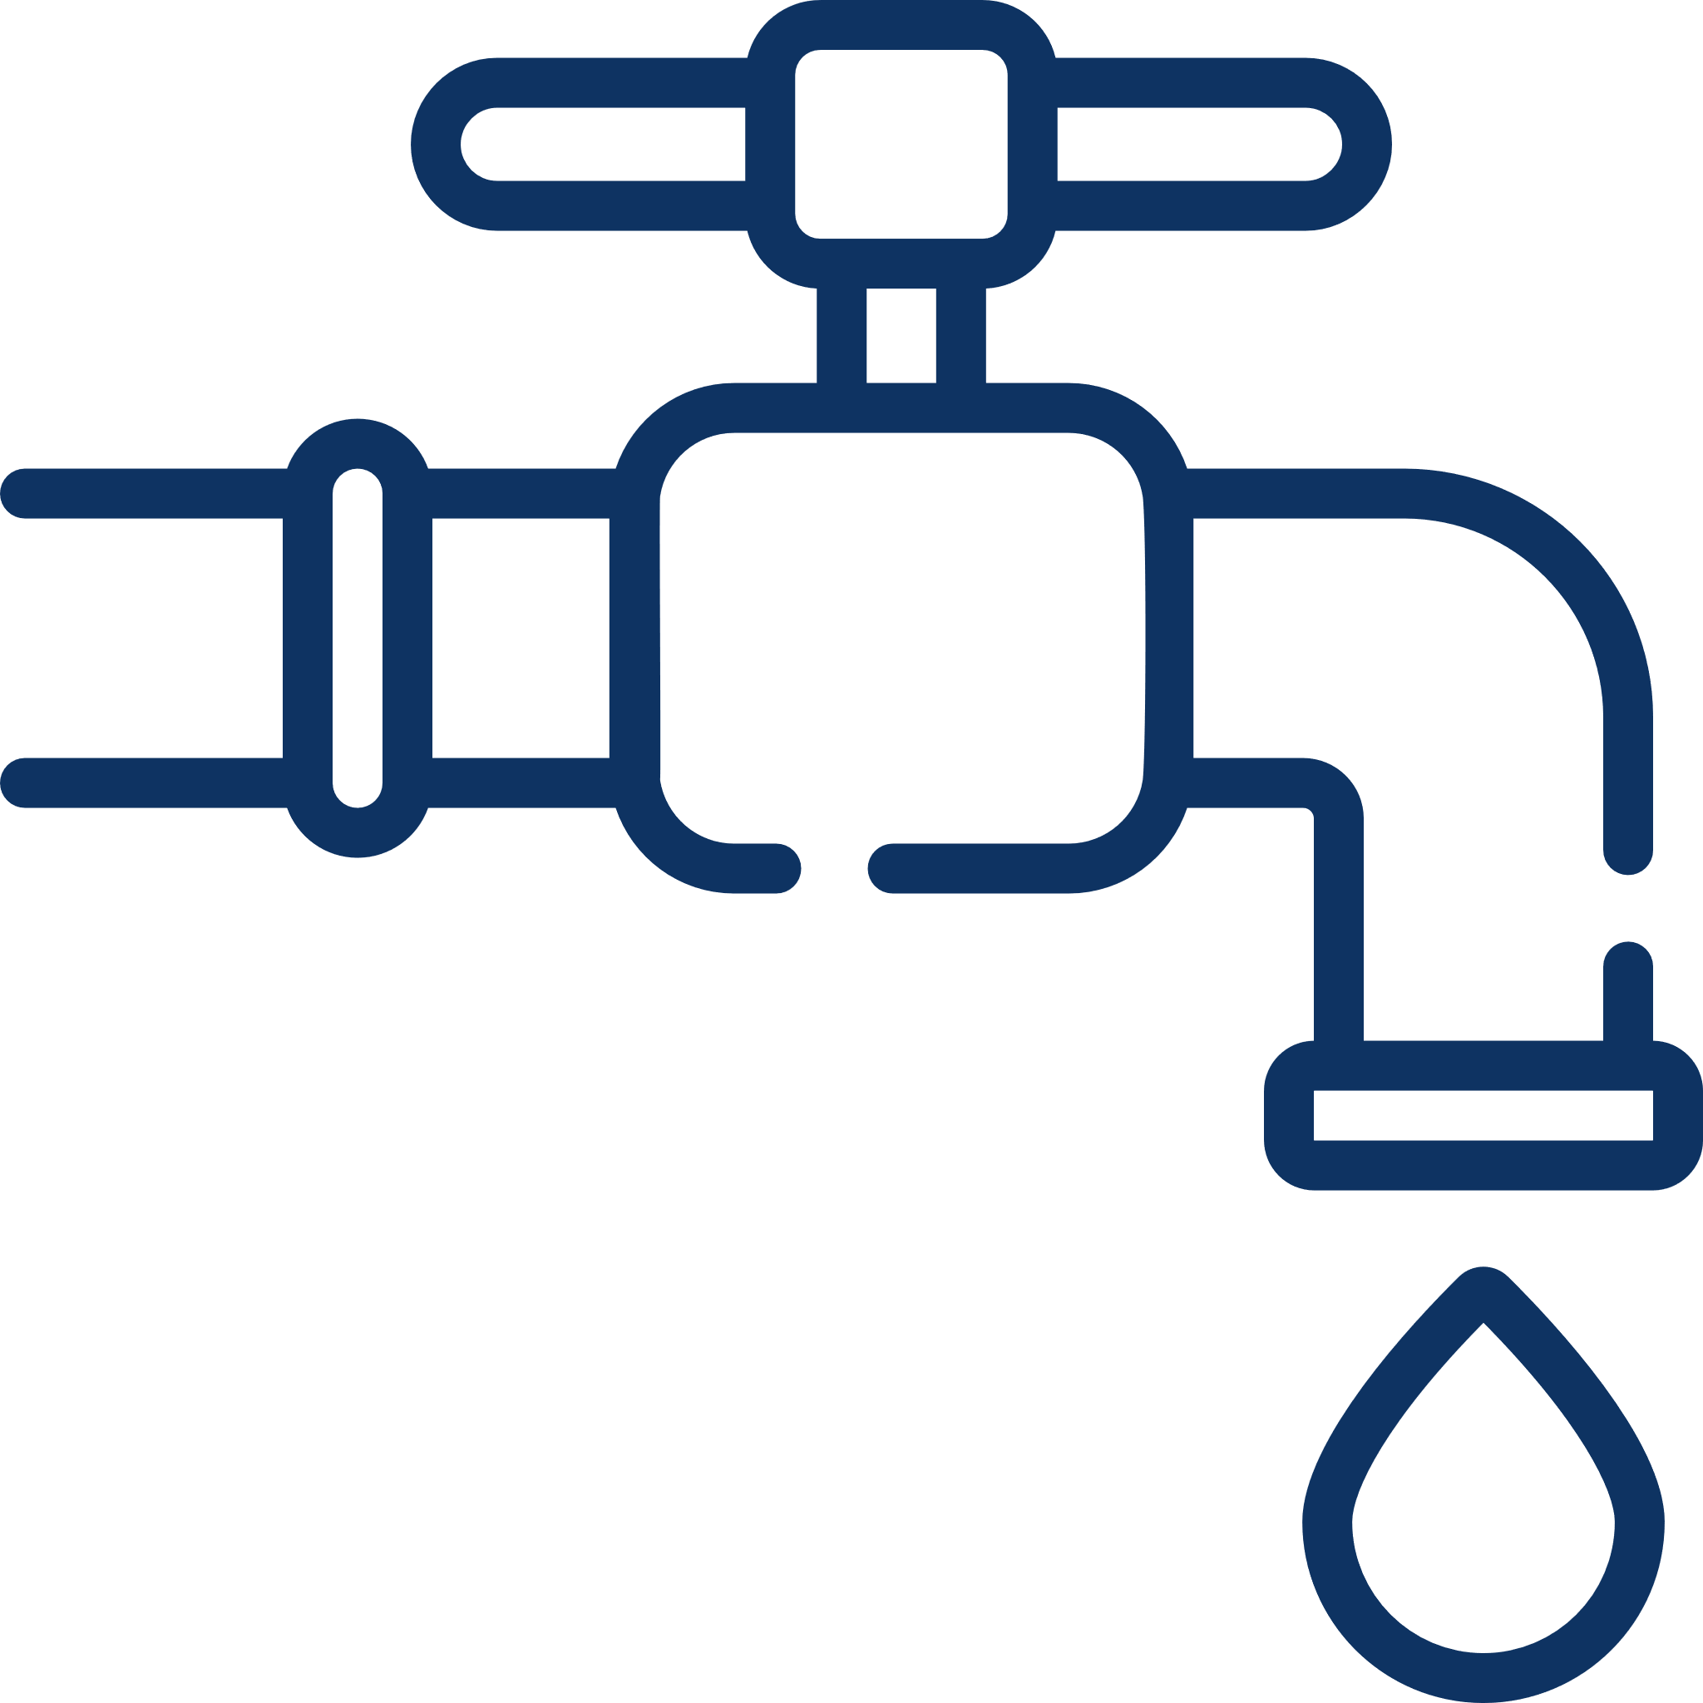

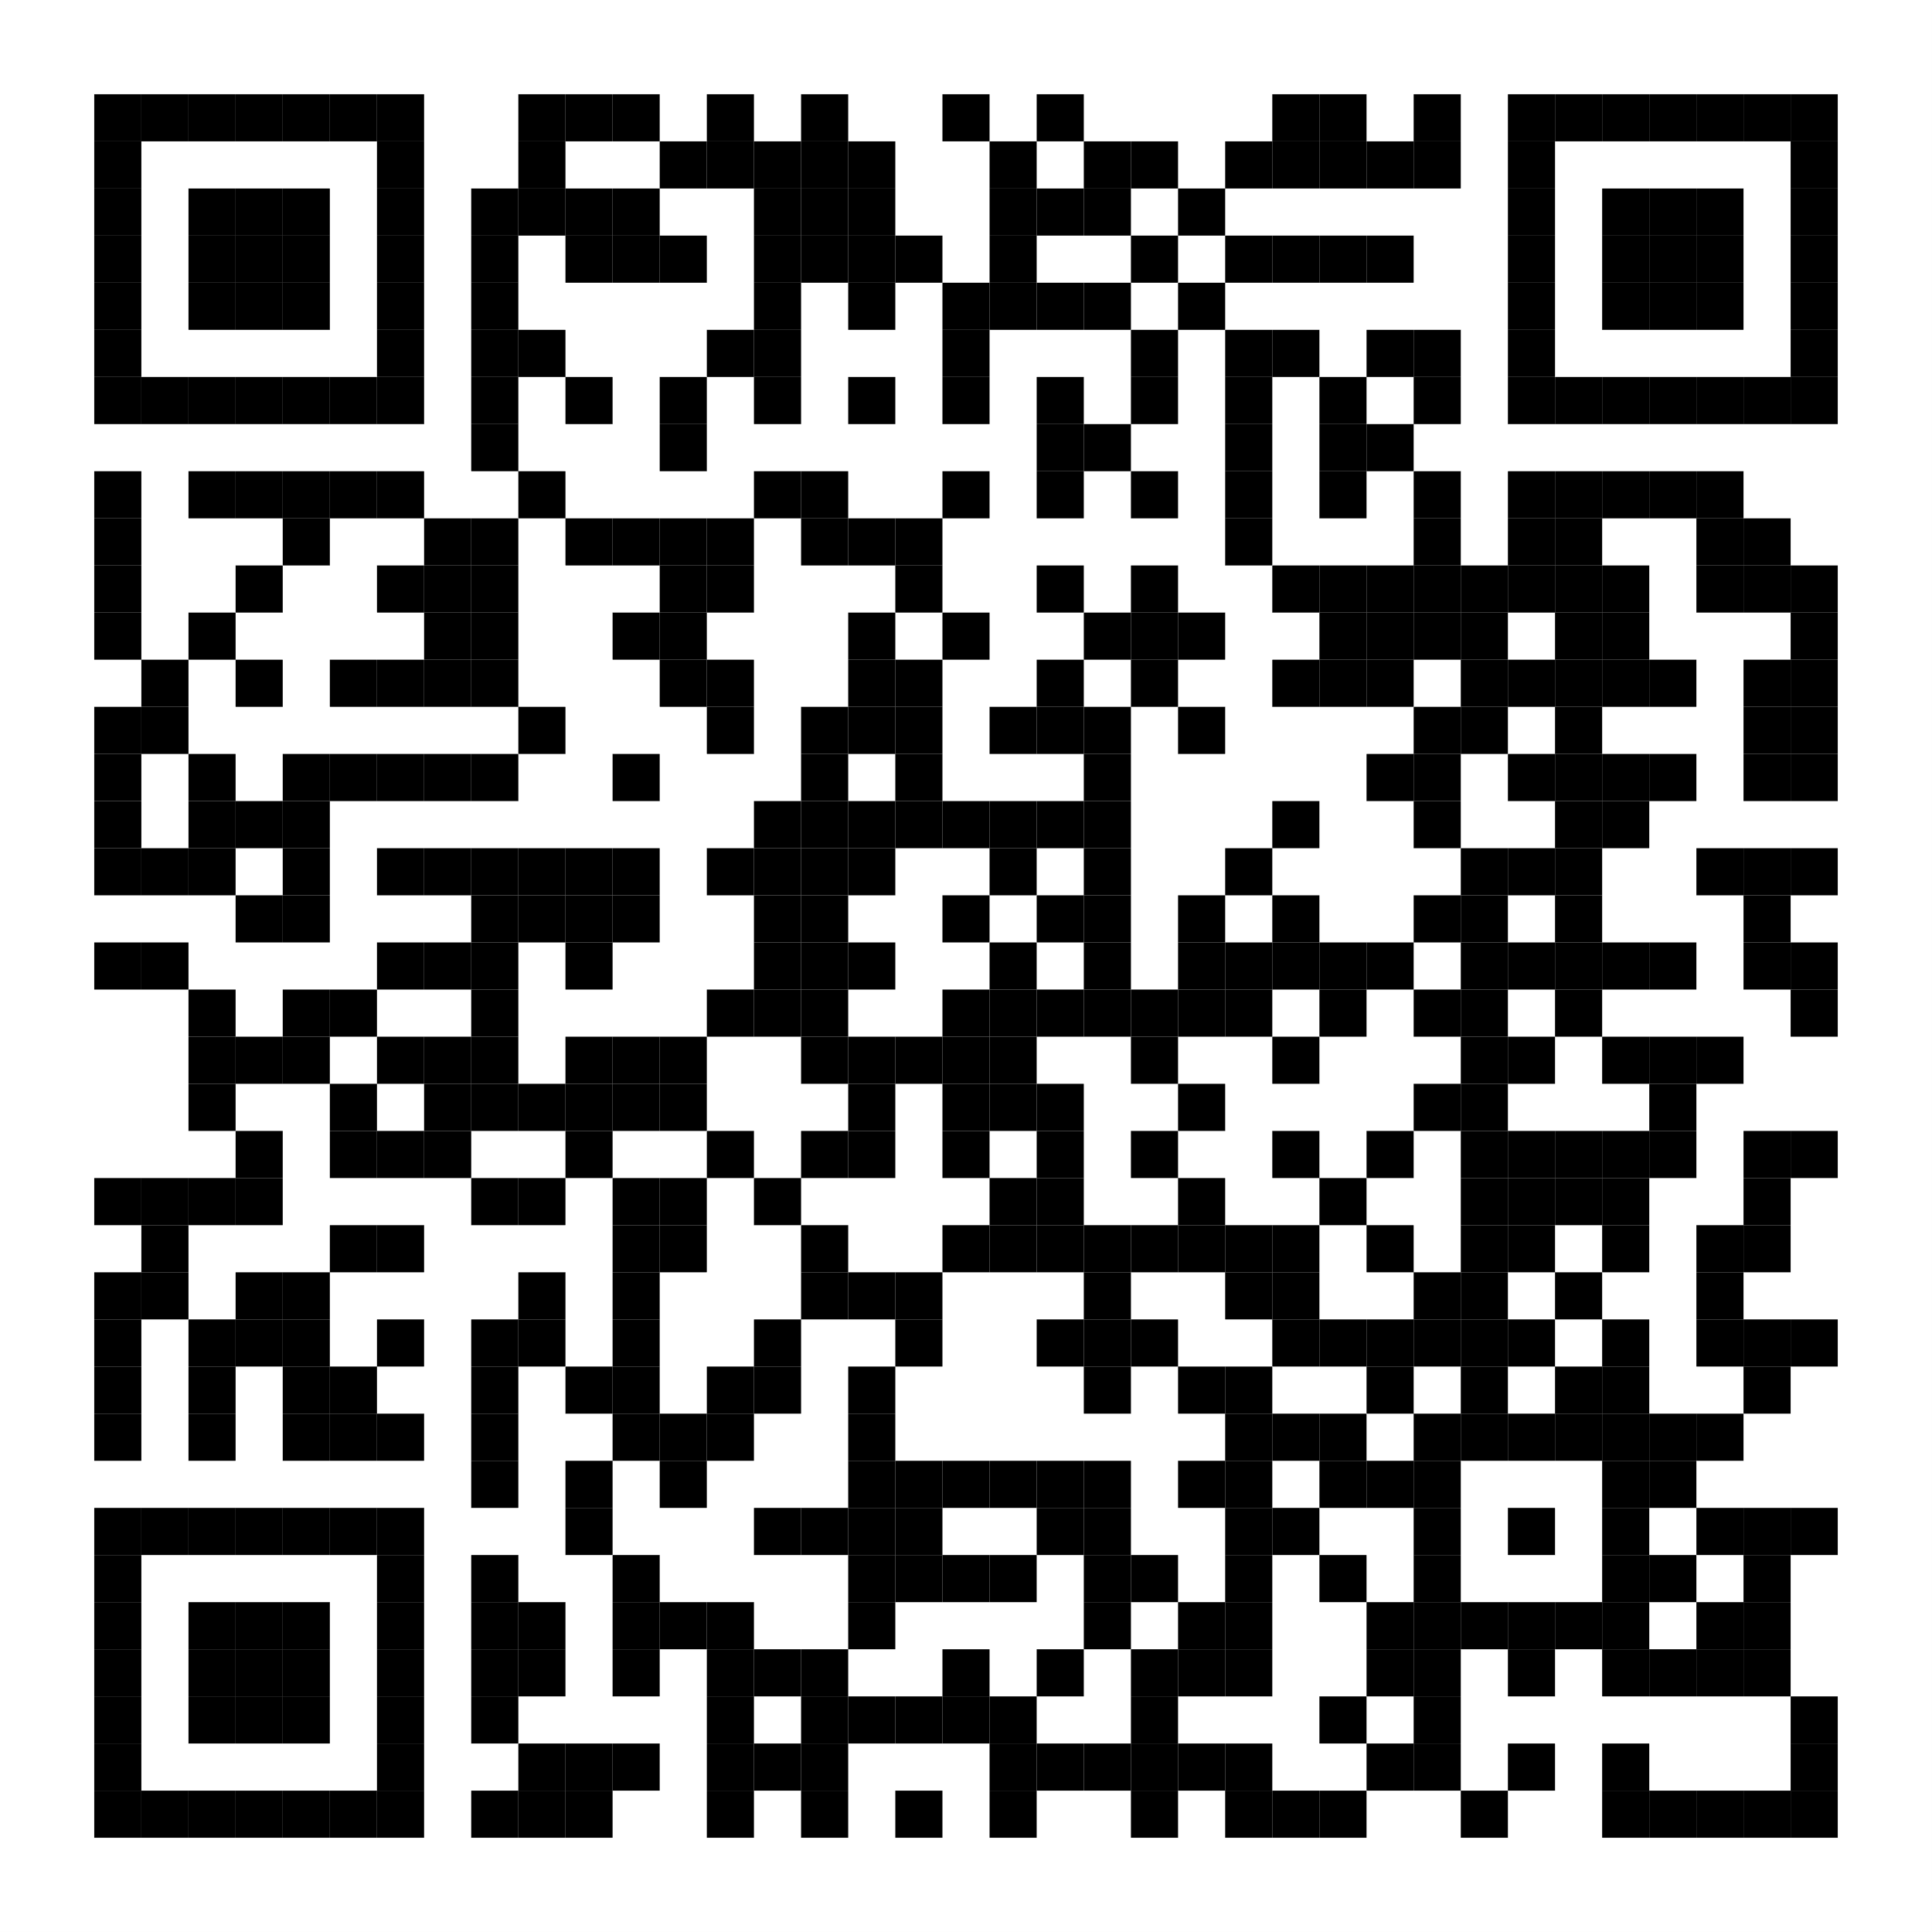
Promoted Zones for Targeted Industries
ปราจีนบุรี
21
Industrial Estates
WHA Rayong Industrial Estate
Eastern Seaboard I.E. (Rayong)
WHA Eastern Industrial Estate (Map Ta Phut)
WHA Eastern Seaboard I.E.1
WHA Chonburi I.E.1
WHA Chonburi I.E.2
WHA Eastern Seaboard I.E.2
WHA Eastern Seaboard I.E.3
WHA Eastern Seaboard I.E.4
CPGC I.E. (Rayong)
Amata City Chonburi I.E.
Amata City Chonburi I.E. (2nd Project)
Amata City Rayong I.E.
Pinthong Industrial Estate
Pinthong Industrial Estate (Laem Chabang)
Pinthong Industrial Estate (3rd Project)
Pinthong Industrial Estate (4th Project)
Pinthong Industrial Estate (5th Project)
TFD I.E. (2nd Project)
Yamato Industries I.E.
Smart Park I.E.
19
12
Chachoengsao
2
Industrial Clusters
B
A
11
Chonburi
14
6
8
20
15
16
7
17
5
18
Next-Generation Automotive Banpho
E-Commerce Bang Pakong
2
4
9
13
Rayong
1
10
21
3
Land Availability*
Total EEC Area:
Total Promoted Zone :
Available Area:
1,326,600 Hectares
(8,291,250 Rai)
14,401.44 Hectares
(90,009 Rai)
3,916.32 Hectares
(24,477 Rai)
Cost of Doing Business
Land Price/Hectare:
(Inside Industrial Estates)
Energy Rate:
Water Rate:
Internet Rate:
Chachoengsao:
Chonburi:
Rayong:
Starting from 1.6M USD
Starting from 800K USD
Starting from 763K USD
0.08 – 0.14 USD/kWh
(2.35 – 4.42 Baht/kWh)
0.31- 0.52 USD/Cubic Meter
(9.5 – 15.81 Baht/Cubic Meter)
19.25 – 97.85 USD/Month
(490 – 2,999 Baht/Month)
*Energy Rate depends
on the size of business
For More Information

Slide 6

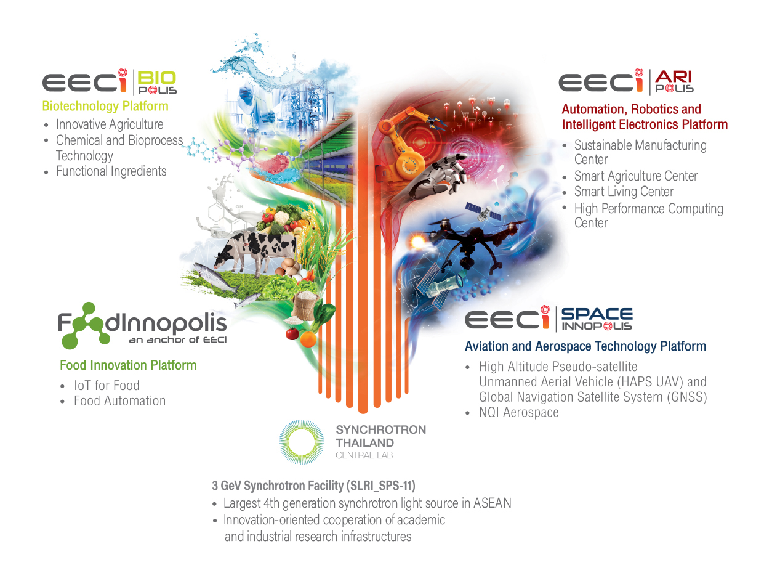
















Innovation Ecosystem at EECi
The Eastern Economic Corridor of Innovation or EECi is an innovation hub located in Wangchan District, Rayong Province, spearheaded by the National Science and Technology Development Agency (NSTDA) to support frontier industries in 6 focused areas:
• Modern Agriculture and Biotechnology
• Biofuels and Biochemicals
• High Performance Battery and Modern Transports
• Automation, Robotics and Smart Electronics
• Aviation and Aerospace
• Medical Devices
Within the Innovation Clusters such as BIOPOLIS, ARIPOLIS, SPACE INNOPOLIS and FOODINNOPOLIS, EECi work closely with research institutes, universities, international firms and government agencies, offer long-term leasehold land, common and scientific infrastructures, 3GeV Synchrotron light source facility (4th generation) as well as investment privileges and incentives, regulatory sandbox and access to talent.
Local Genome Database from ‘Genomics Thailand’
Genomics Thailand is a collaborative human genome research network in Thailand located at Burapha University, Chonburi Province. To help accelerate the genomics research and drug discovery process, Genomics Thailand plans to develop a genome library of at least 50,000 Whole Genome Sequencing Cases in Thailand to estimate genetic factors that influence susceptibility to specific diseases or traits among Thais.
Genomics Thailand is led by Thailand National Institute of Health, Department of Medical Sciences, Ministry of Public Health with 7 Focus Areas:
Cancer Precision
Medicine
Rare and Undiagnosed Diseases
Non-Communicable Diseases
Non-Invasive Prenatal Testing (NIPT)
Newborn Screening
Pharmacogenomics for Rational Drug Use (RDU)
Precision Health
Future of Connectivity with 5G
“Thailand is the leader in ASEAN
for commercial 5G roll out”
Transportation & Logistics
Healthcare
Consumer & Tourism
Support for Digital Lifestyle and Industrial Applications
Manufacturing
Feb 16, 2020
Mar 2020
1st country in ASEAN for 5G license auction
Commercial 5G service roll out
Agriculture
Education
5G spectrum is expected to cover 50% of the EEC Promoted Zones within March 2021.
Apart from supporting digital lifestyle for the connected consumers, 5G in EEC area aims to facilitate the industrial requirement for critical, low-latency, digital use cases such as Autonomous Vehicle and Remote Surgery.
The pilot use cases in the EEC Promoted Zones are being implemented through the collaboration between EEC and Thai Robotic Communities such as Thai Automation and Robotics Association (TARA), Centers of Robotics Excellence (CoRE) and Thai Association
of Artificial Intelligence.
Source: Office of The National Broadcasting and Telecommunications Commission
Notes:
https://en.prnasia.com/releases/apac/thailand-s-eastern-economic-corridor-promotes-genomics-project-as-center-of-medical-hub-287458.shtm
https://www.marketsandmarkets.com/Market-Reports/genomics-market-613.html?gclid=CjwKCAjwkoz7BRBPEiwAeKw3q9lSZnfvqAwHFBvFbXSBrkzDtiItoSoo93ZkVtnuORNwZKD_aRaNsBoCSZYQAvD_BwEl

Slide 7

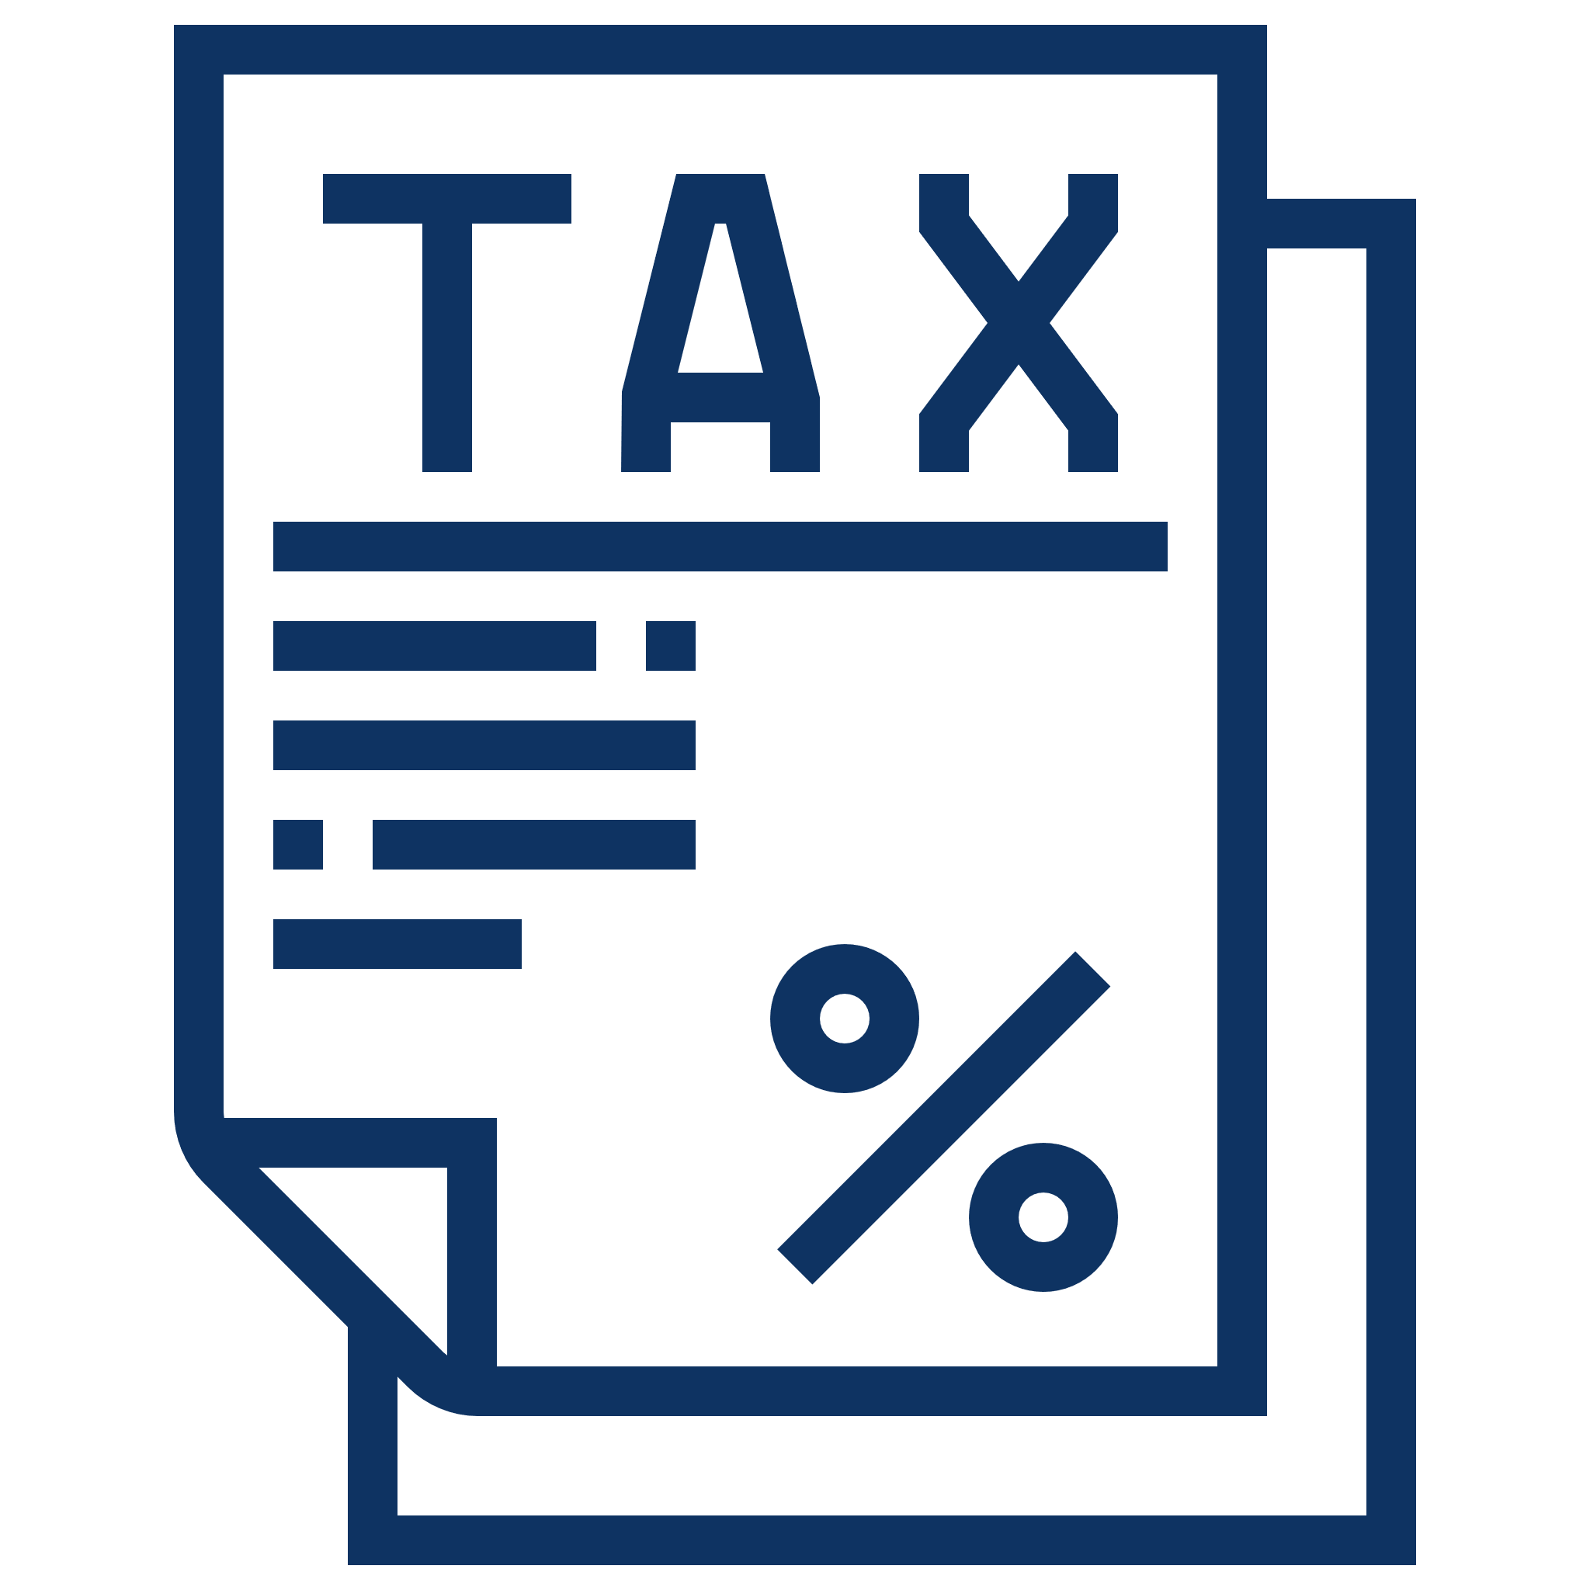










Investment Incentives
BOI Investment Incentives for EEC (2020 – 2021)
1
Key Feature | Investment Incentive | For Targeted Business Activities
 |  | Section 8 | A1 | A2 | A3
1. Standard Tax Package | Tax holiday | 10 Years (No Cap) | 8 Years (No Cap) | 8 Years - | 5 Years -
Human Resource Development Programs (Additional Tax Incentives)
2. Investment Projects, engaging in human resource development program | Tax holiday | 2 Years (No Cap) | - | - | -
 | 50% reduction of CIT | - | 3 Years | 3 Years | 3 Years
Projects Located in the Promoted Zones or industrial estates
3. Investments located in Promoted Zones for Specific Industries; EECi, EECd, EECa, EECmd and EECg | Tax holiday | 1 Years | - | - | -
 | 50% reduction of CIT | - | 2 Years | 2 Years | 2 Years
OR
3. Investments located in Promoted Zones for Targeted Industries or industrial estates | Tax holiday | 1 Years | - | - | 1 Years
 | 50% reduction of CIT | - | - | - | -
Note
A1: Knowledge-based activities focusing on R&D and design to enhance the country’s competitiveness
A2: Infrastructure activities for the country’s development, activities using advanced technology to create value –add , with no or very few existing investment in Thailand.
A3: High technology activities which are important to the development of the country, with a few investment already existing in Thailand.
Section 8: Technology and Innovation Development includes targeted core technology development such as development biotechnology, nanotechnology, advanced materials technology and digital technology.
EEC Incentives
2
According to the EEC Act, investors may receive any one or more of the following rights or benefits as specified by the Policy Committee
An exemption of corporate income tax the same special privilege under the Board of Investment Act and Competitiveness Enhancement Act (CIT exemption up to 15 years)
Ownership on land for business and condominium for business and living
Bringing in foreign nationals who are top management, skill-workers or experts to enter and work in Thailand
An exemption of import duties the same special privilege under the Board of Investment Act and Competitiveness Enhancement Act
An exemption from the foreign majority ownership and effective control restrictions under the Thai Air Navigation Act for a production certificate for aircraft or major aircraft appliances, and for a repair station certificate.
The same rights as the business operators in the duty-free zones, bonded warehouses, or free trade zones
An exemption from compliance with the law on currency exchange control wholly or partly, and to use foreign currencies for payment of goods prices or services in special economic promotion zone
A personnel income tax for foreign national top management and experts
An exemption from the law that only allows Thai applicants for professional permits, license, registration, or certification
Other Enablers
3
EEC Sandbox
Relaxing restrictions on testing and developing innovation for future commercial use
EEC One Stop Service (EEC-OSS)
Facilitating permit application process through digital channel for 44 permits
Long-Term Land Lease
Extending the leasehold contracts from 30 to 50+49 years

Slide 8




Contact EEC
We Make Entry Easier
EEC’s dedicated team will guide you towards successful development of investment projects. Our team can advise and accompany you throughout the journey.
How to get in touch
We welcome any inquiries. Please feel free to contact us at
Eastern Economic Corridor (EEC)
25th Floor CAT Tower, 72 Soi Wat Maungkhae, Charoenkrung Road, Bangrak, Bangkok 10500 Thailand
+66 2033 8000
info@eeco.or.th
For further information
Disclaimer: This fact sheet is created by the Eastern Economic Corridor Office of Thailand (EECO) to provide you with the preliminary information regarding the development of the Eastern Economic Corridor (EEC) area. The information in this fact sheet was last updated on 22 Dec 2020 and is subject to change. EECO reserves the right to revise the information in accordance with our discretion and without any prior notice.
The content presented in this fact sheet including information, images, and graphics are the copyright of EECO. In no event will EECO be liable for any damages caused as a result, directly or indirectly, of the use of this fact sheet, including but not limited to losses or expenses incurring from any inaccuracy, error, omission, timeliness, completeness, deletion, communication line failure, alteration of, or use of any content herein.
© Dec 2020 Copyright

